Slide 1


Slide 2


Slide 3
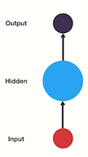



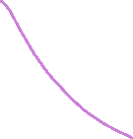

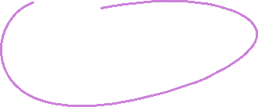



Feed Forward Neural Network

Slide 4
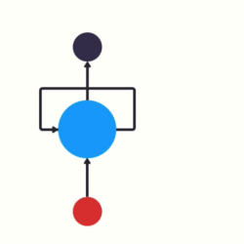
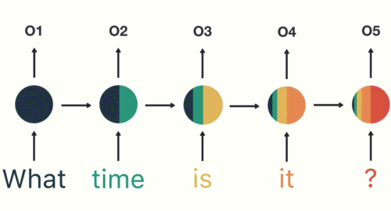
Passing Hidden State to next time step

Slide 5
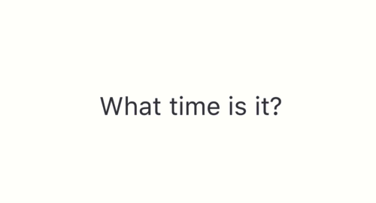
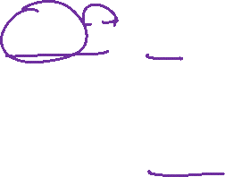
Breaking up a sentence into word sequences

Slide 6
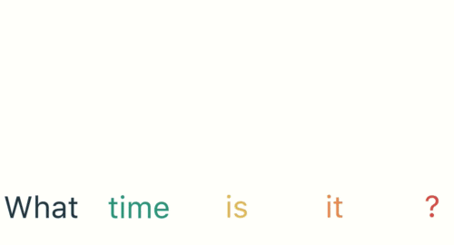
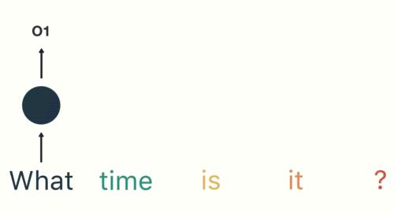

Slide 7


Slide 8

Final hidden state of the RNN

Slide 9
Final hidden state of the RNN

Slide 10
FNN Feed Forward Neural Networks

Slide 11
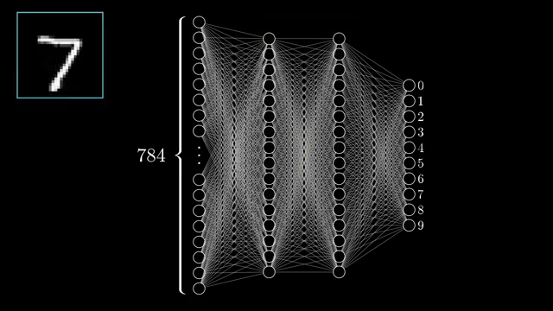

Slide 12
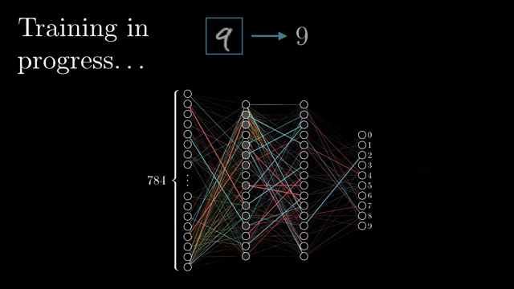

Slide 13
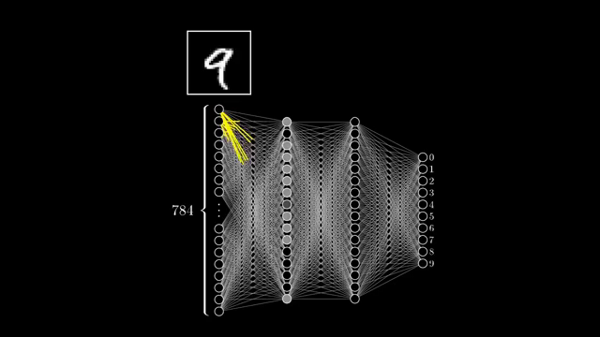

Slide 14
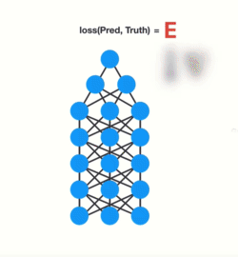
Gradients shrink as it back-propagates down

Slide 15
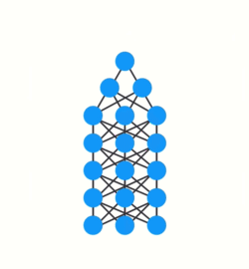

Slide 16
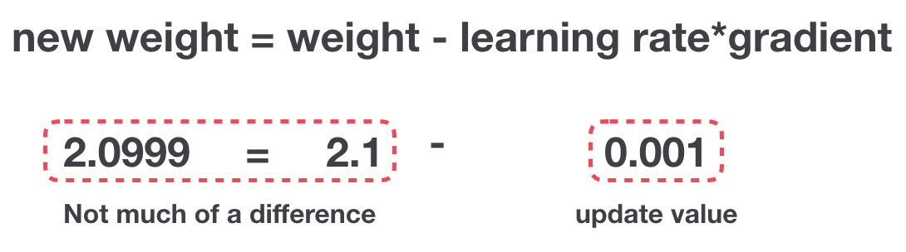
Gradient Update Rule

Slide 17
Gradient Update Rule

Slide 18
RNN Recurrent Neural Networks

Slide 19




Slide 20


Slide 21

An unrolled recurrent neural network.

Slide 22
An unrolled recurrent neural network.

Slide 23
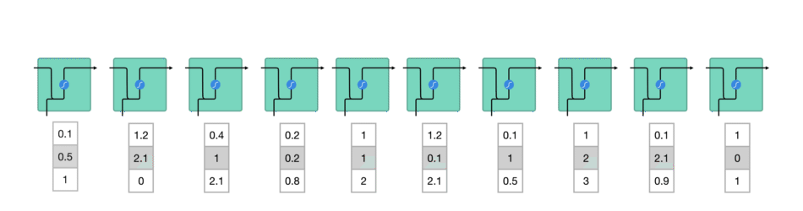
Processing sequence one by one

Slide 24
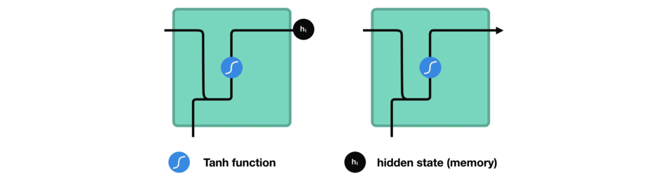
Passing hidden state to next time step

Slide 25
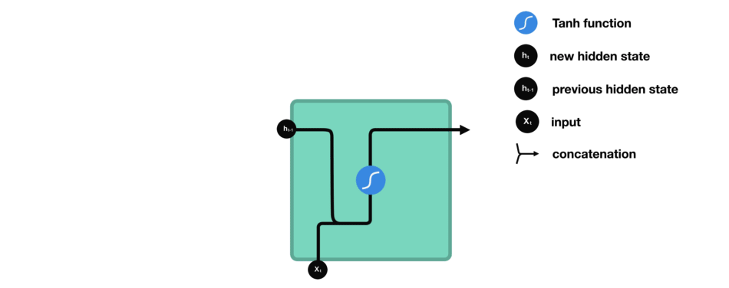

Slide 26
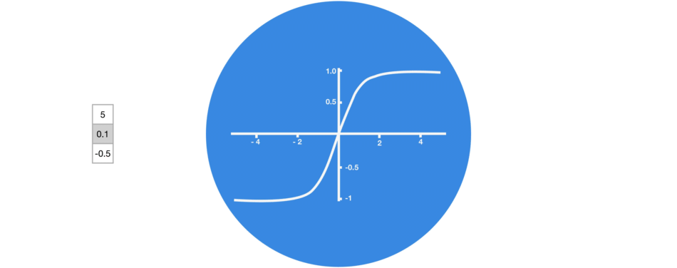
Tanh squishes values to be between -1 and 1

Slide 27
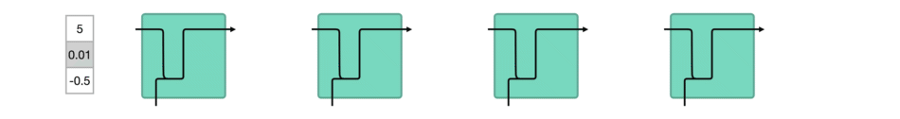
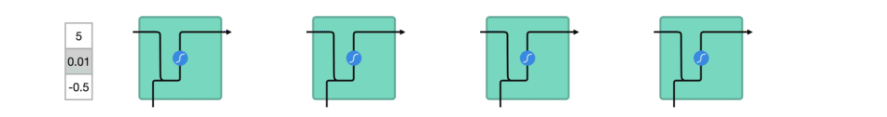
vector transformations without tanh
vector transformations with tanh

Slide 28
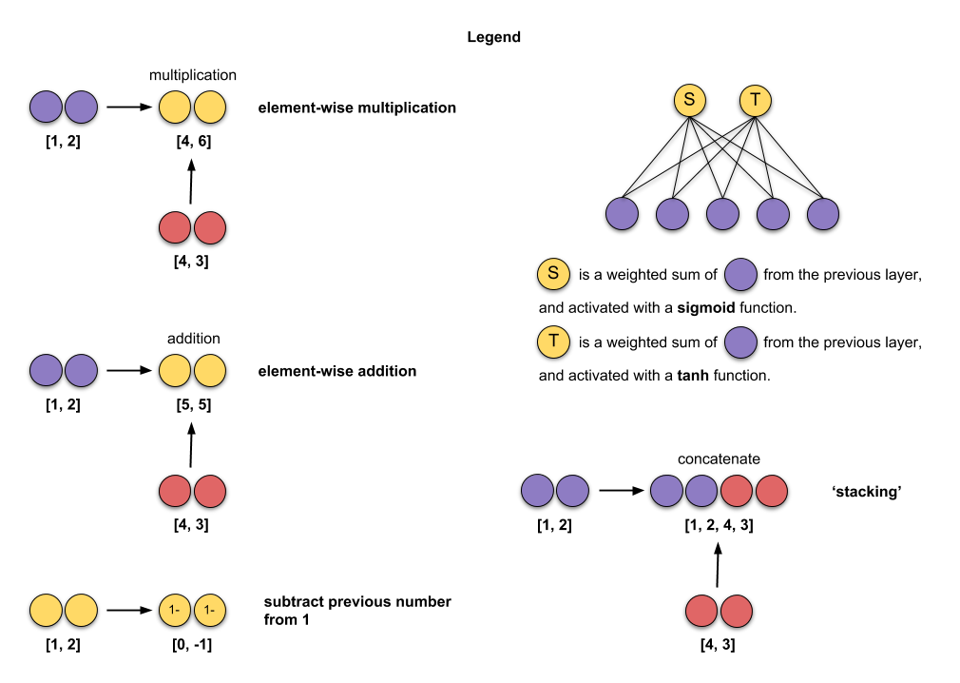

Slide 29
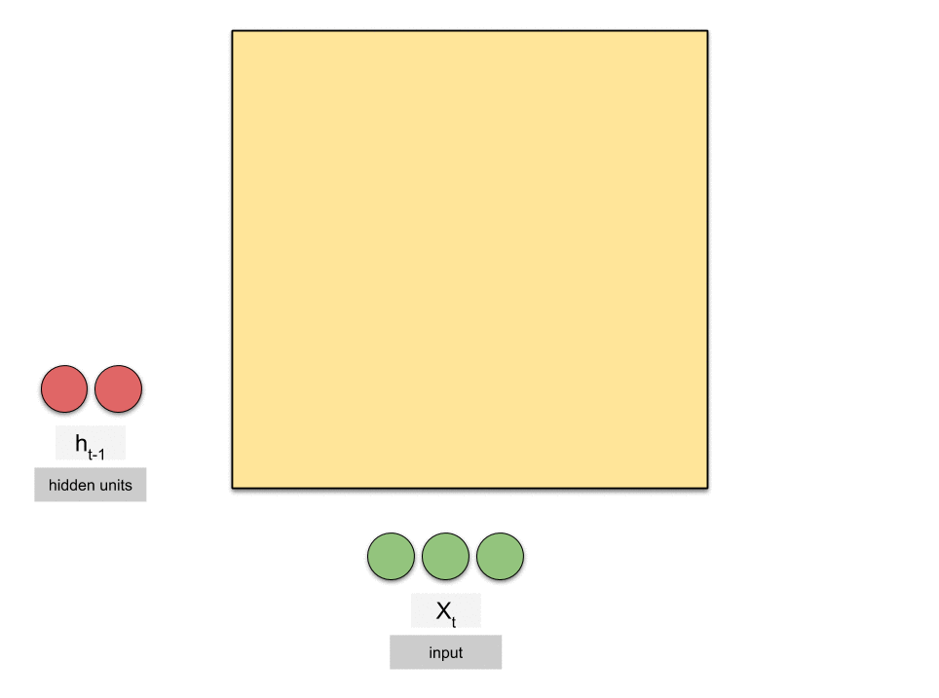
X — input
h — hidden state
t — time step
length of X — size/dimension of input
length of h — no. of hidden units.
Note that different libraries call them differently, but they mean the same: - Keras — state_size ,units - PyTorch — hidden_size - TensorFlow — num_units

Slide 30
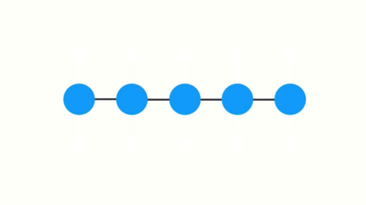
Gradients shrink as it back-propagates through time

Slide 31
LSTM Long Short-Term Memory

Slide 32
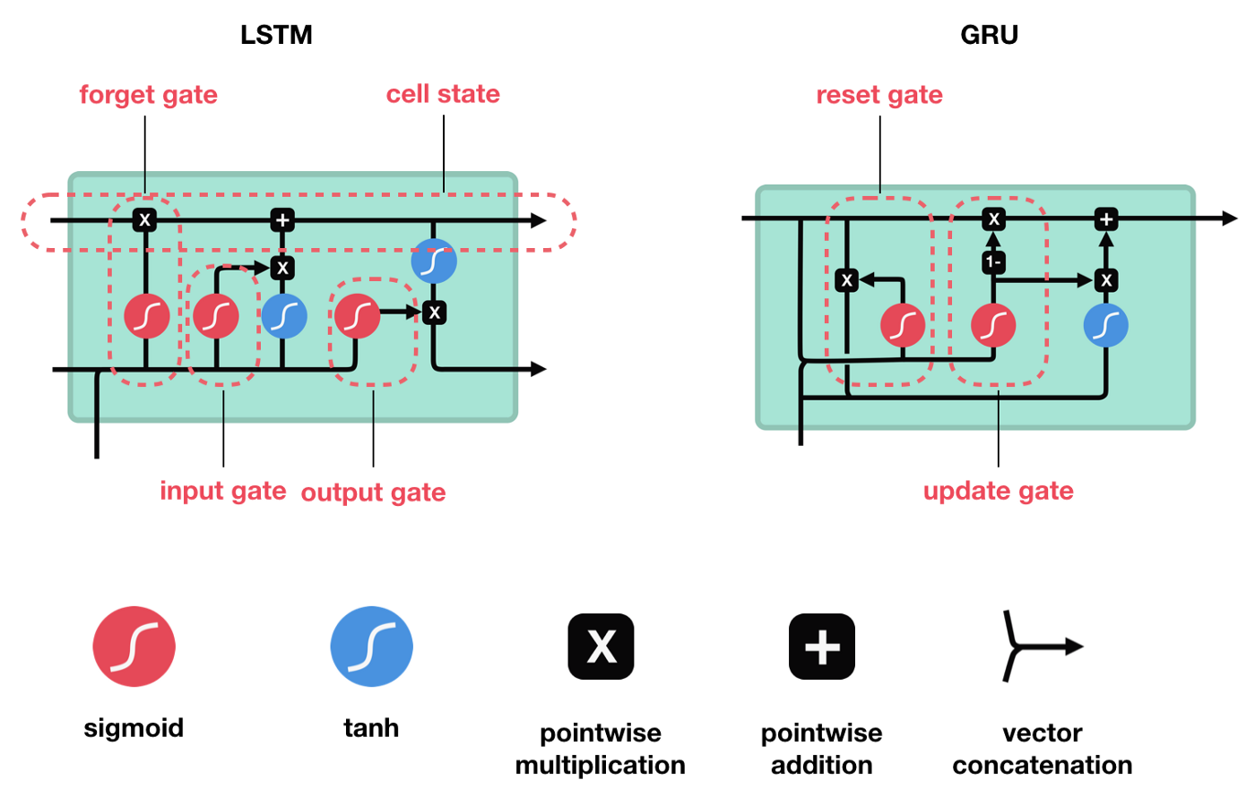

Slide 33
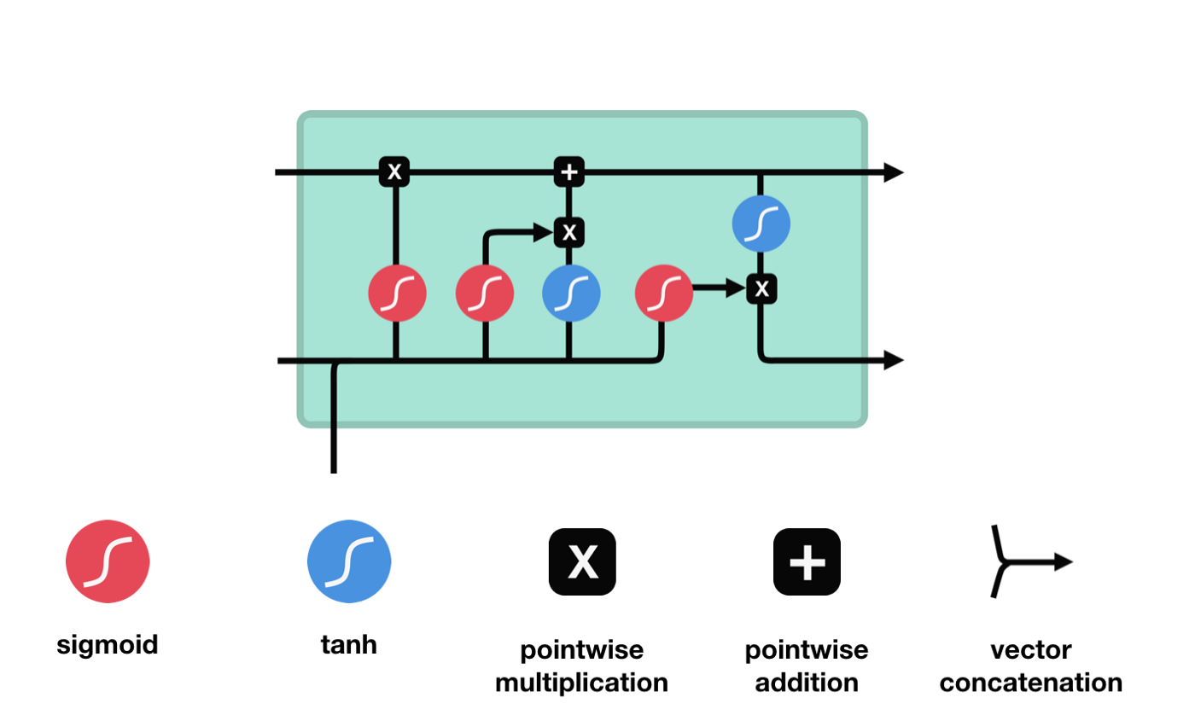
LSTM Cell and It’s Operations

Slide 34
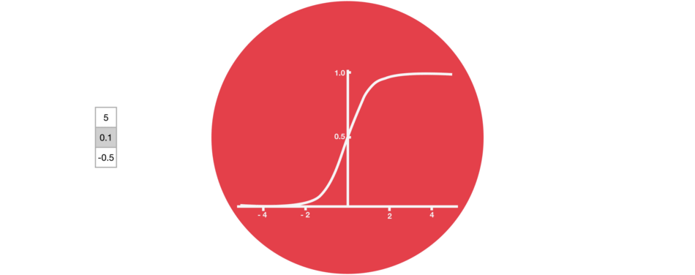
Sigmoid squishes values to be between 0 and 1

Slide 35
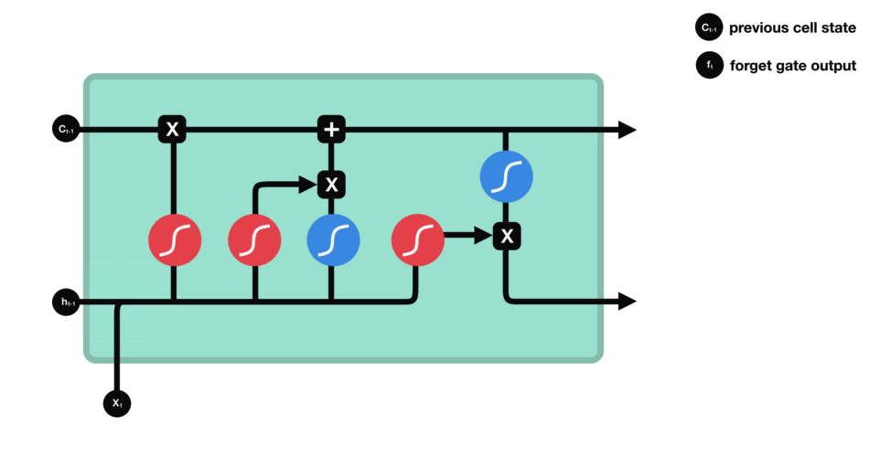


Forget gate operations

Slide 36
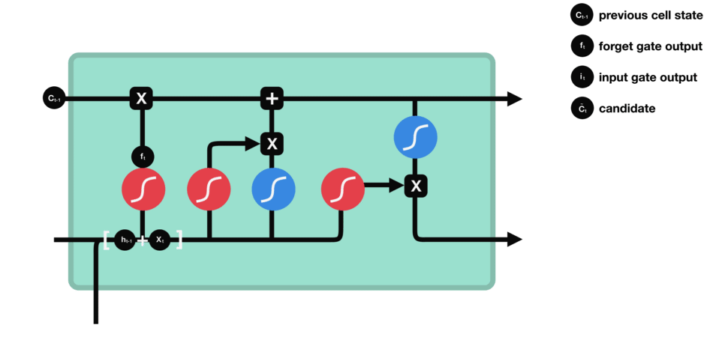





Input gate operations

Slide 37
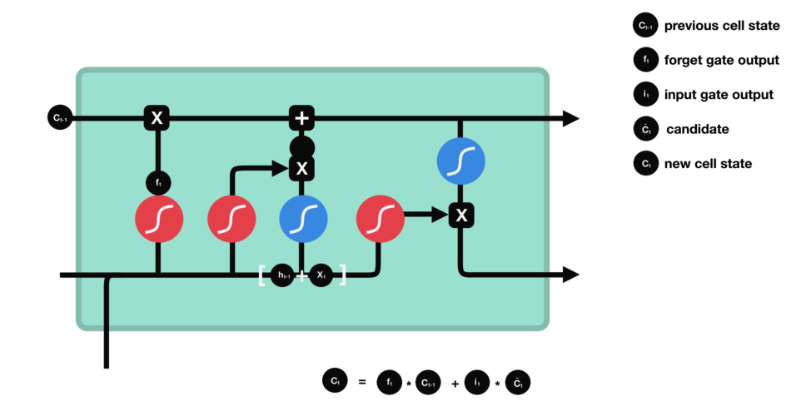





















Calculating cell state

Slide 38






output gate operations

Slide 39
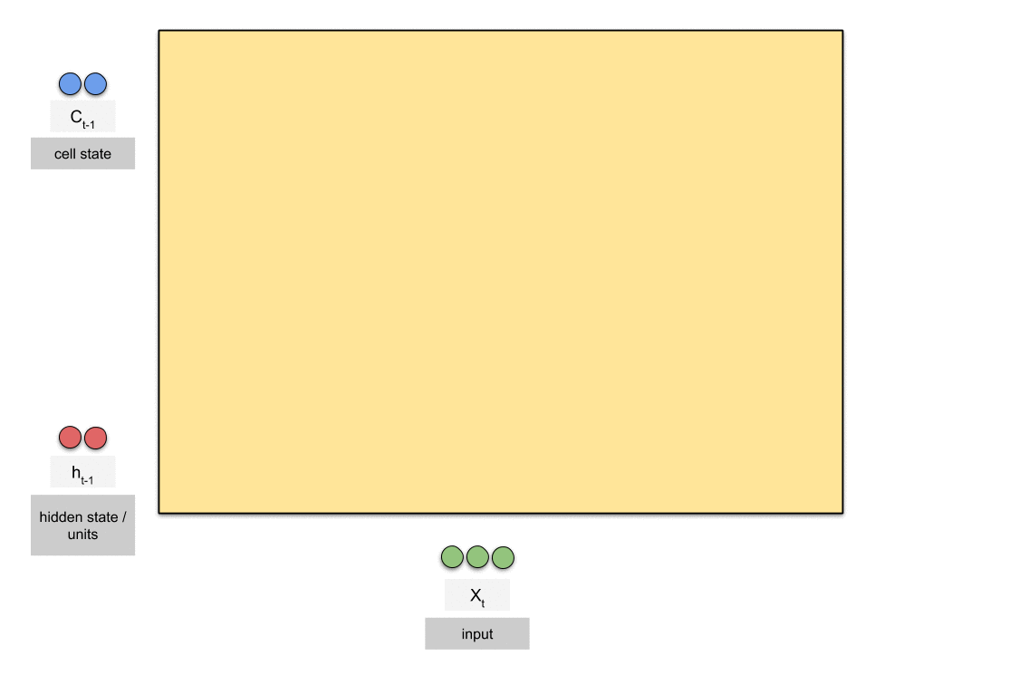
C — cell state
Note that the dimension of the cell state is the same as that of the hidden state

Slide 40
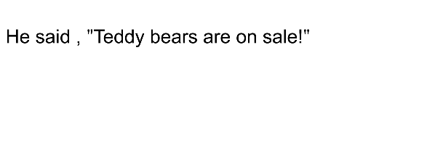

Sometimes to understand a word we need not just to the previous word , but also to the coming word , like in this example

Slide 41
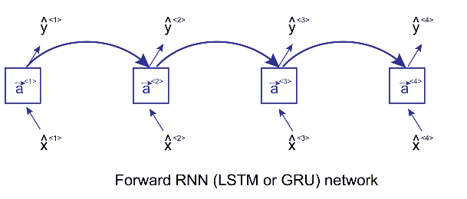

Slide 42
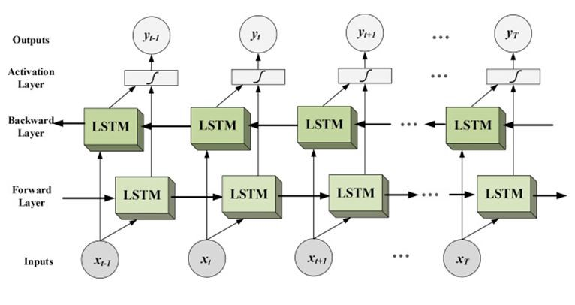




Slide 43
GRU Gated Recurrent Units

Slide 44
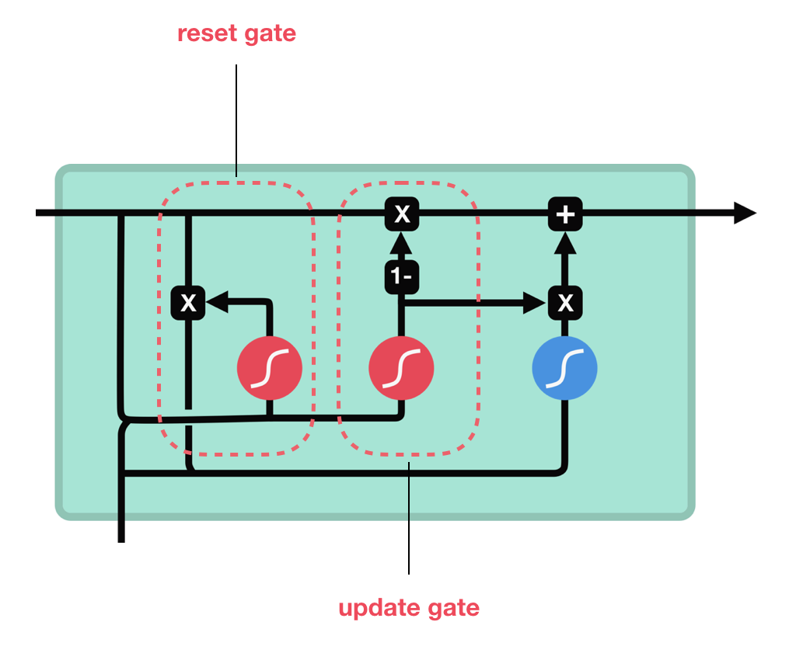




GRU cell and it’s gates

Slide 45
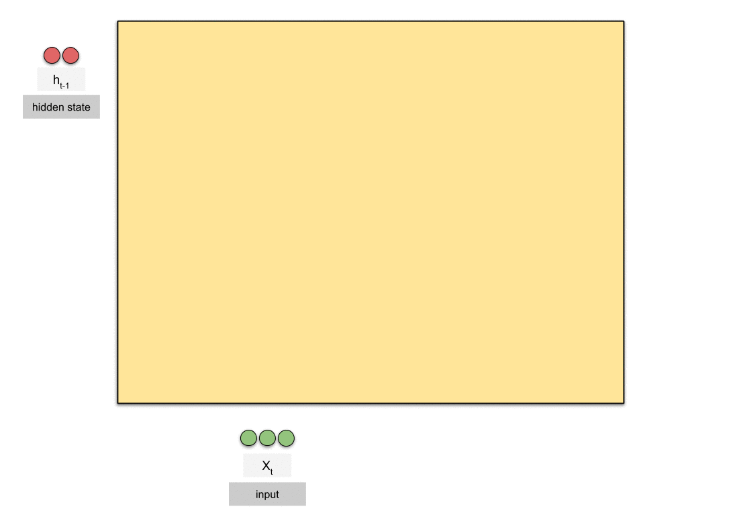

Slide 46
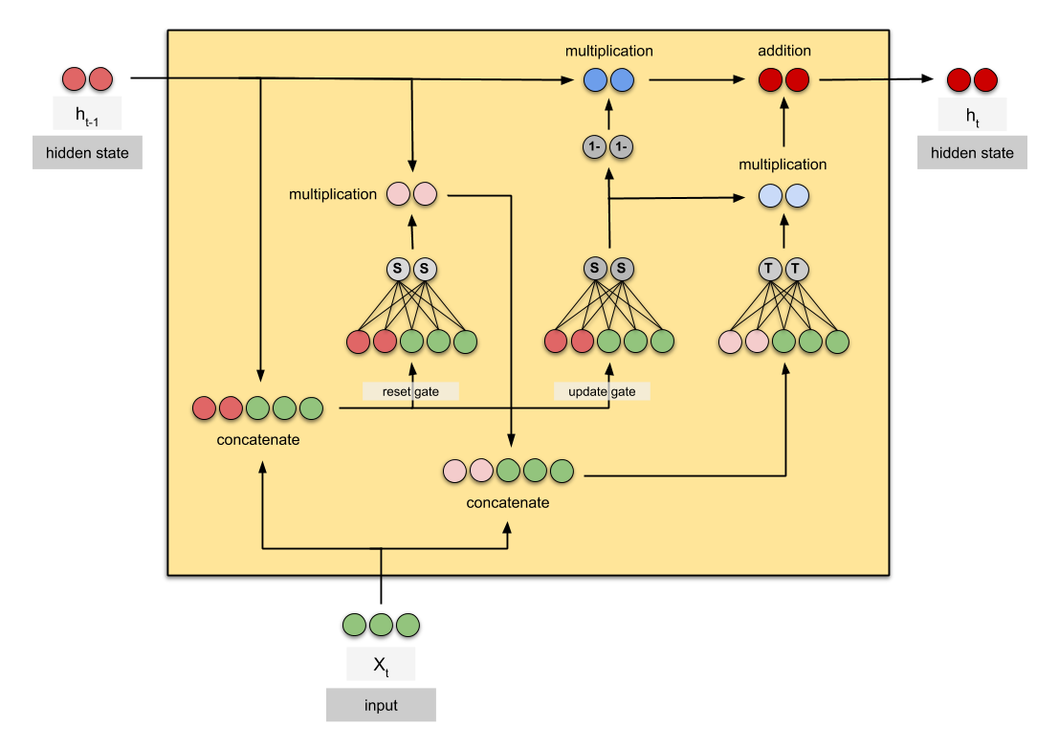

Slide 47
BPPT Back-Propagation Through Time

Slide 48
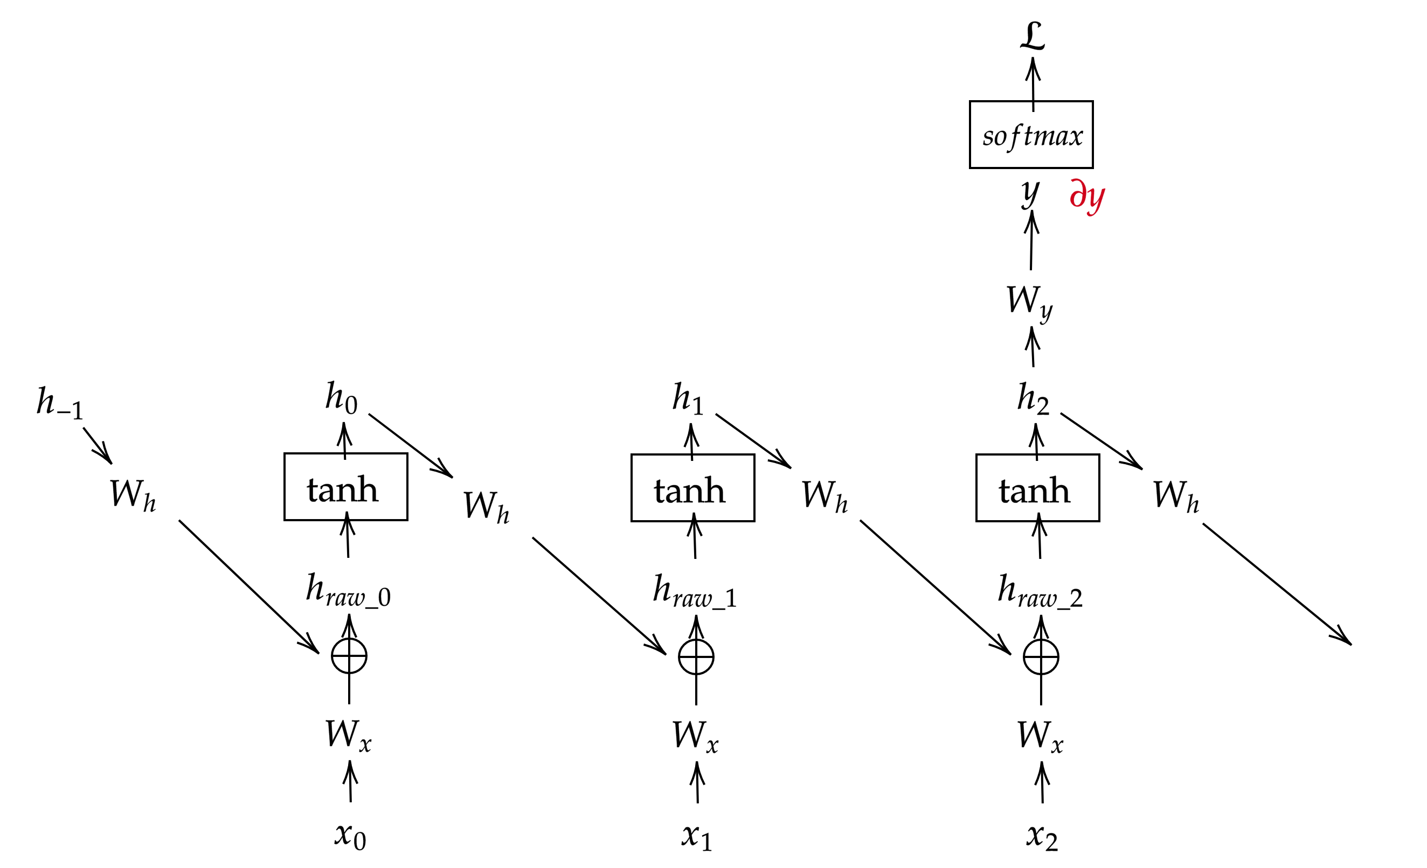
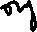



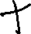


Backprop in RNN

Slide 49
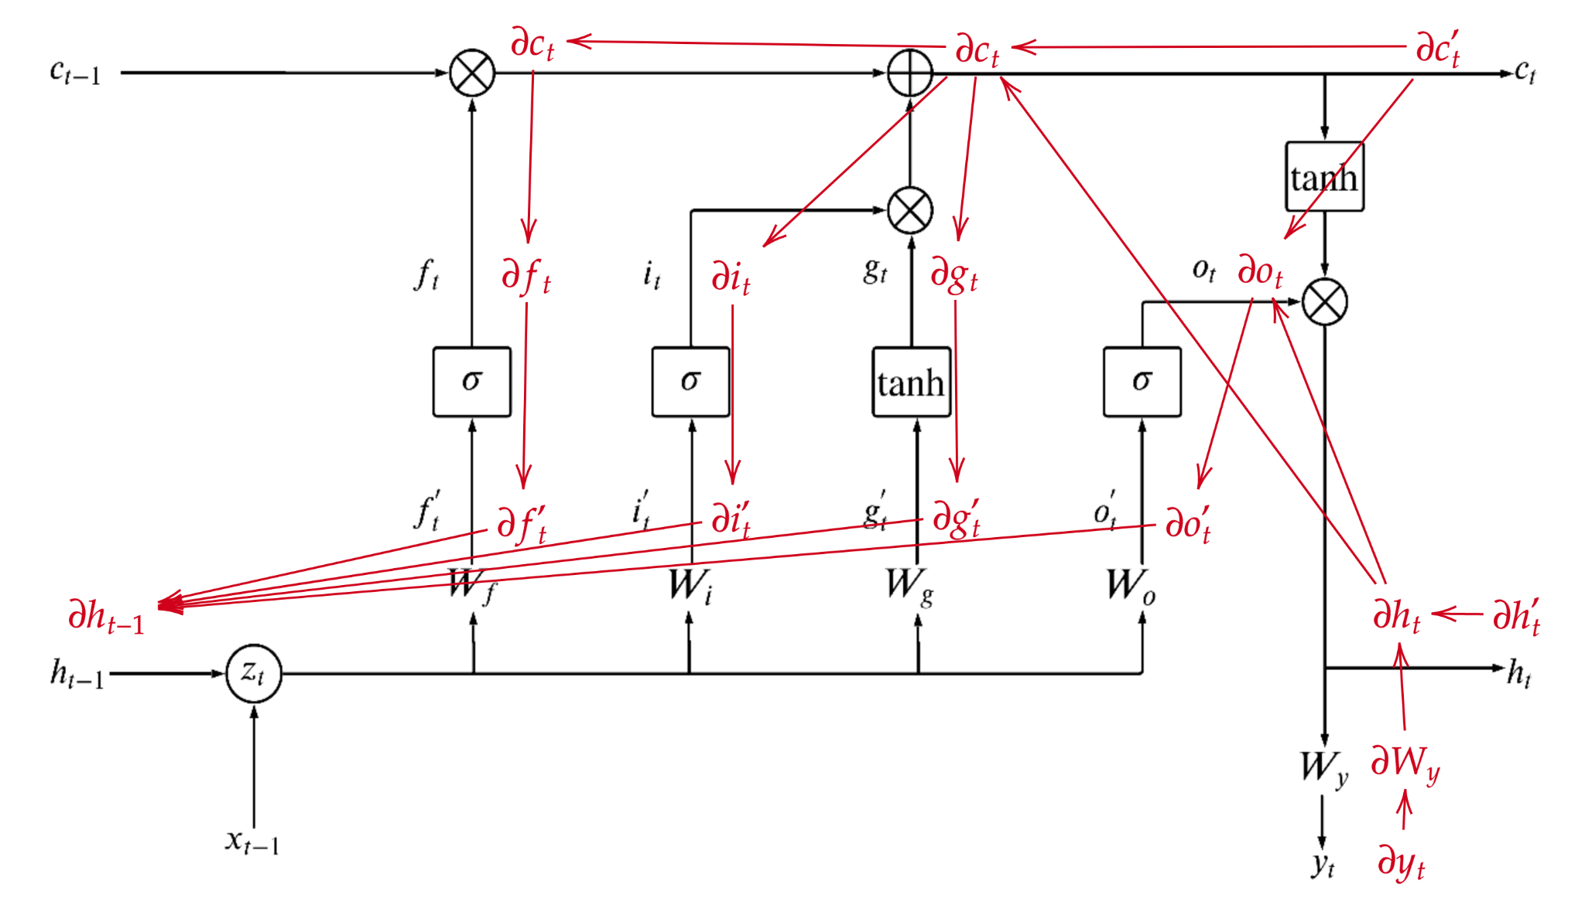
Backprop in LSTM

Slide 50
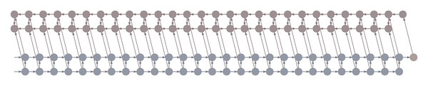
Waybackprop (tensorflow.org)

Slide 51
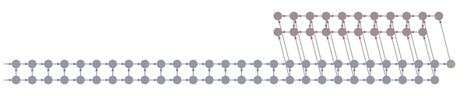
The animation shows the computation of nodes’ values over time. Each node is computed as soon as its dependencies are available.
Note that while this ordering is logically valid, due to practical concerns it may not correspond to the actual ordering implemented in symbolic computation packages such as Theano and Tensorflow.
Truncated backpropagation through time conceptually looks like above

Slide 52
Both the forward and the backward graph are shown, as well as the connections between them.
Blue nodes represent hidden states, and the corresponding red node represents the gradient of the loss with respect to the hidden state.
The loss node is shown in yellow at the far right. Inputs, outputs and parameters are omitted for simplicity. Computing the gradient with respect to the parameters is straightforward given the gradients with respect to the hidden states.

Slide 53


Plus junction: element-by-element addition
3
4
3 + 6
9
5
=
=
4 + 7
11
6
5 + 8
13
7
8

Slide 54



Times junction: element-by-element multiplication
3
4
3 x 6
18
5
=
=
4 x 7
28
6
5 x 8
40
7
8

Slide 55
Gating
0.8
Signal
0.8
0.8 x 1.0
0.8
0.8
=
=
0.8 x 0.5
0.4
1.0
0.8 x 0.0
0.0
On / Off
gating
0.5
0.0

